Slide 1
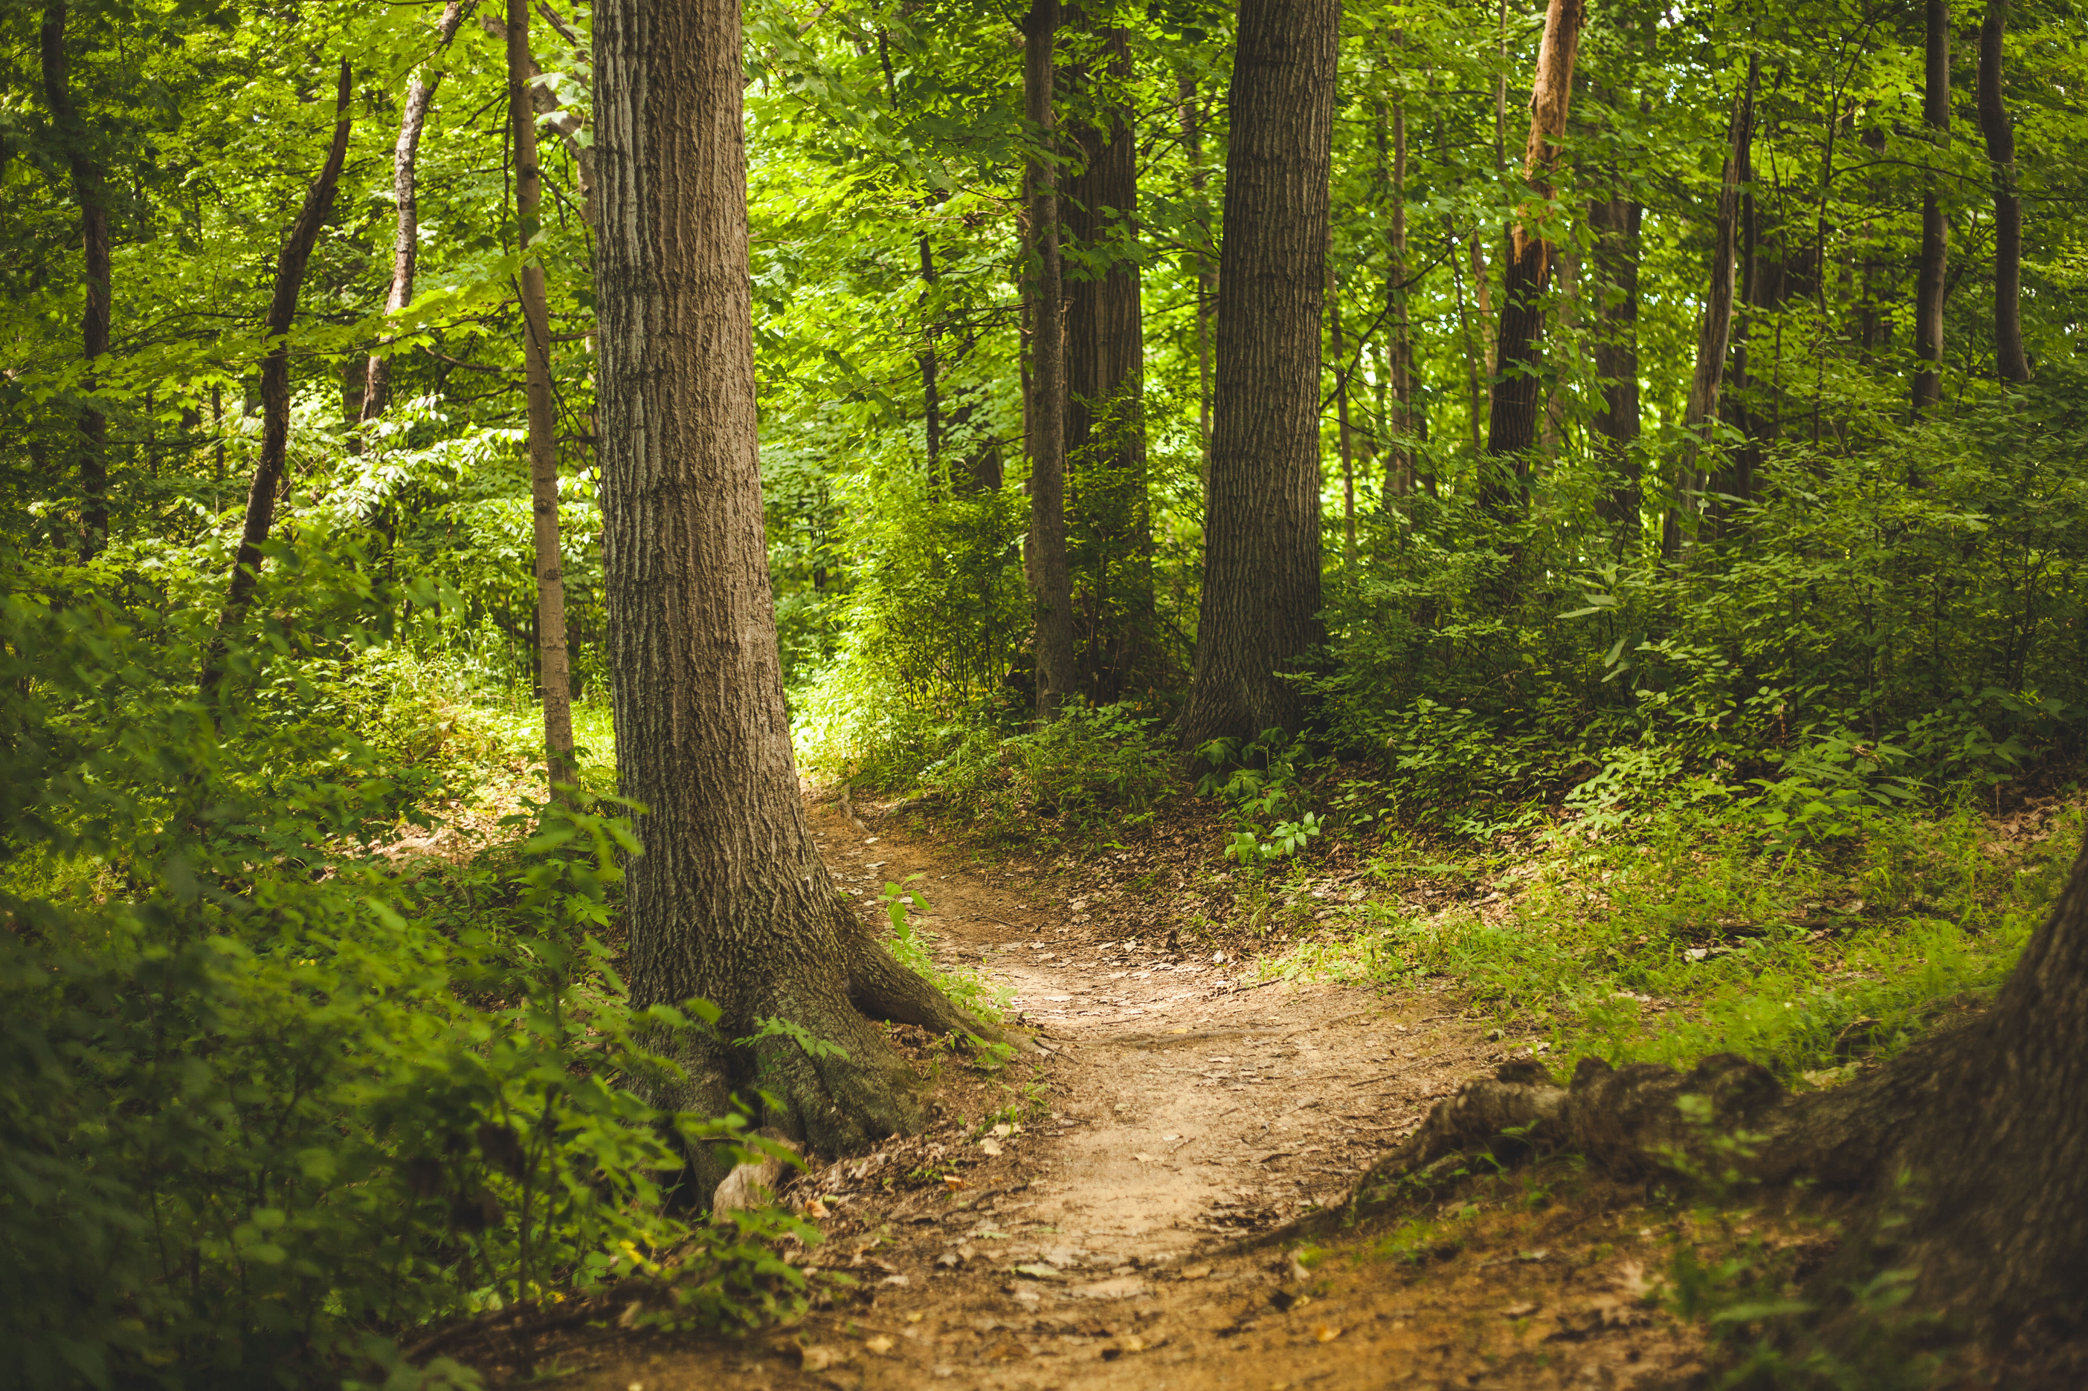
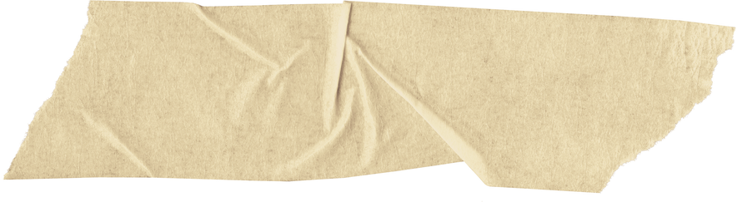

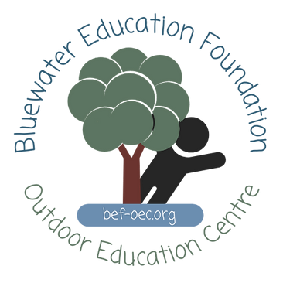

Forest Communities

Slide 2
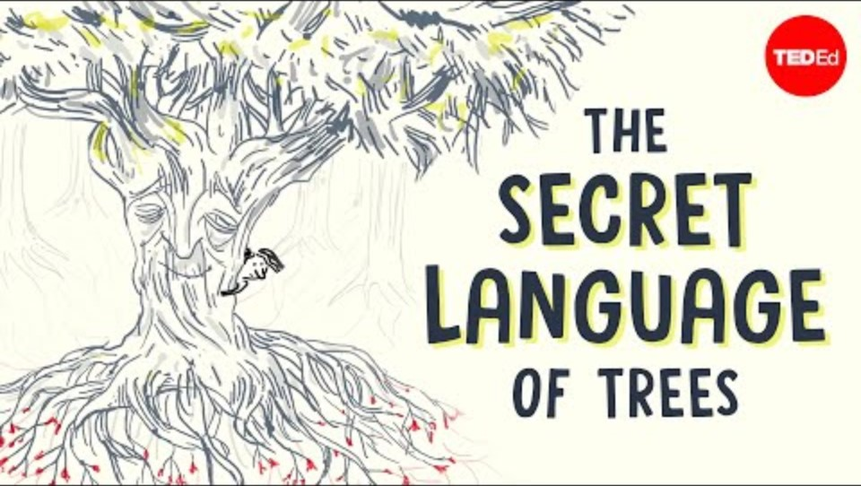
Source: TEDEd

Slide 3
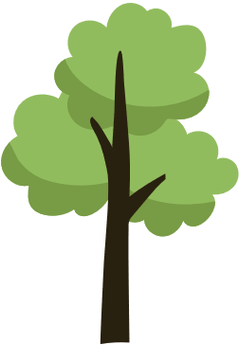
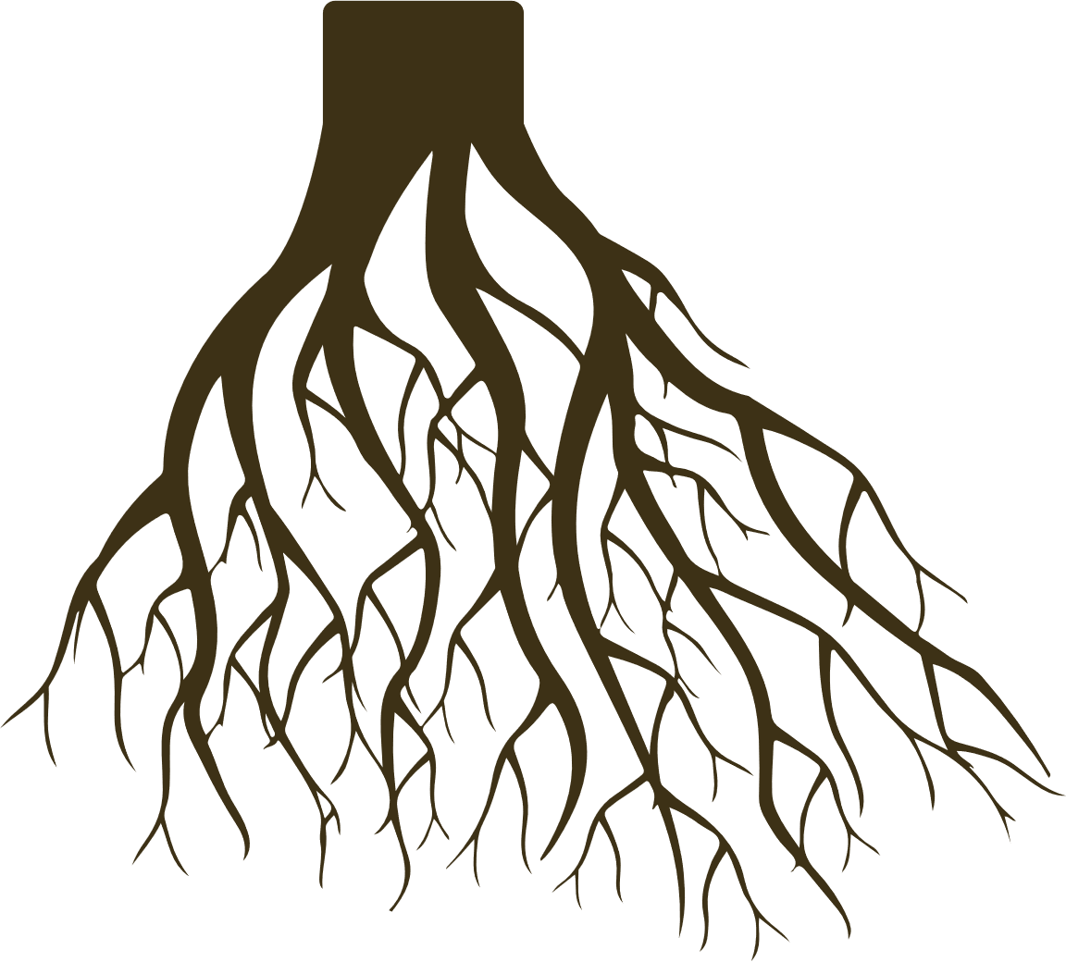
Root systems support the trees above.

Slide 4
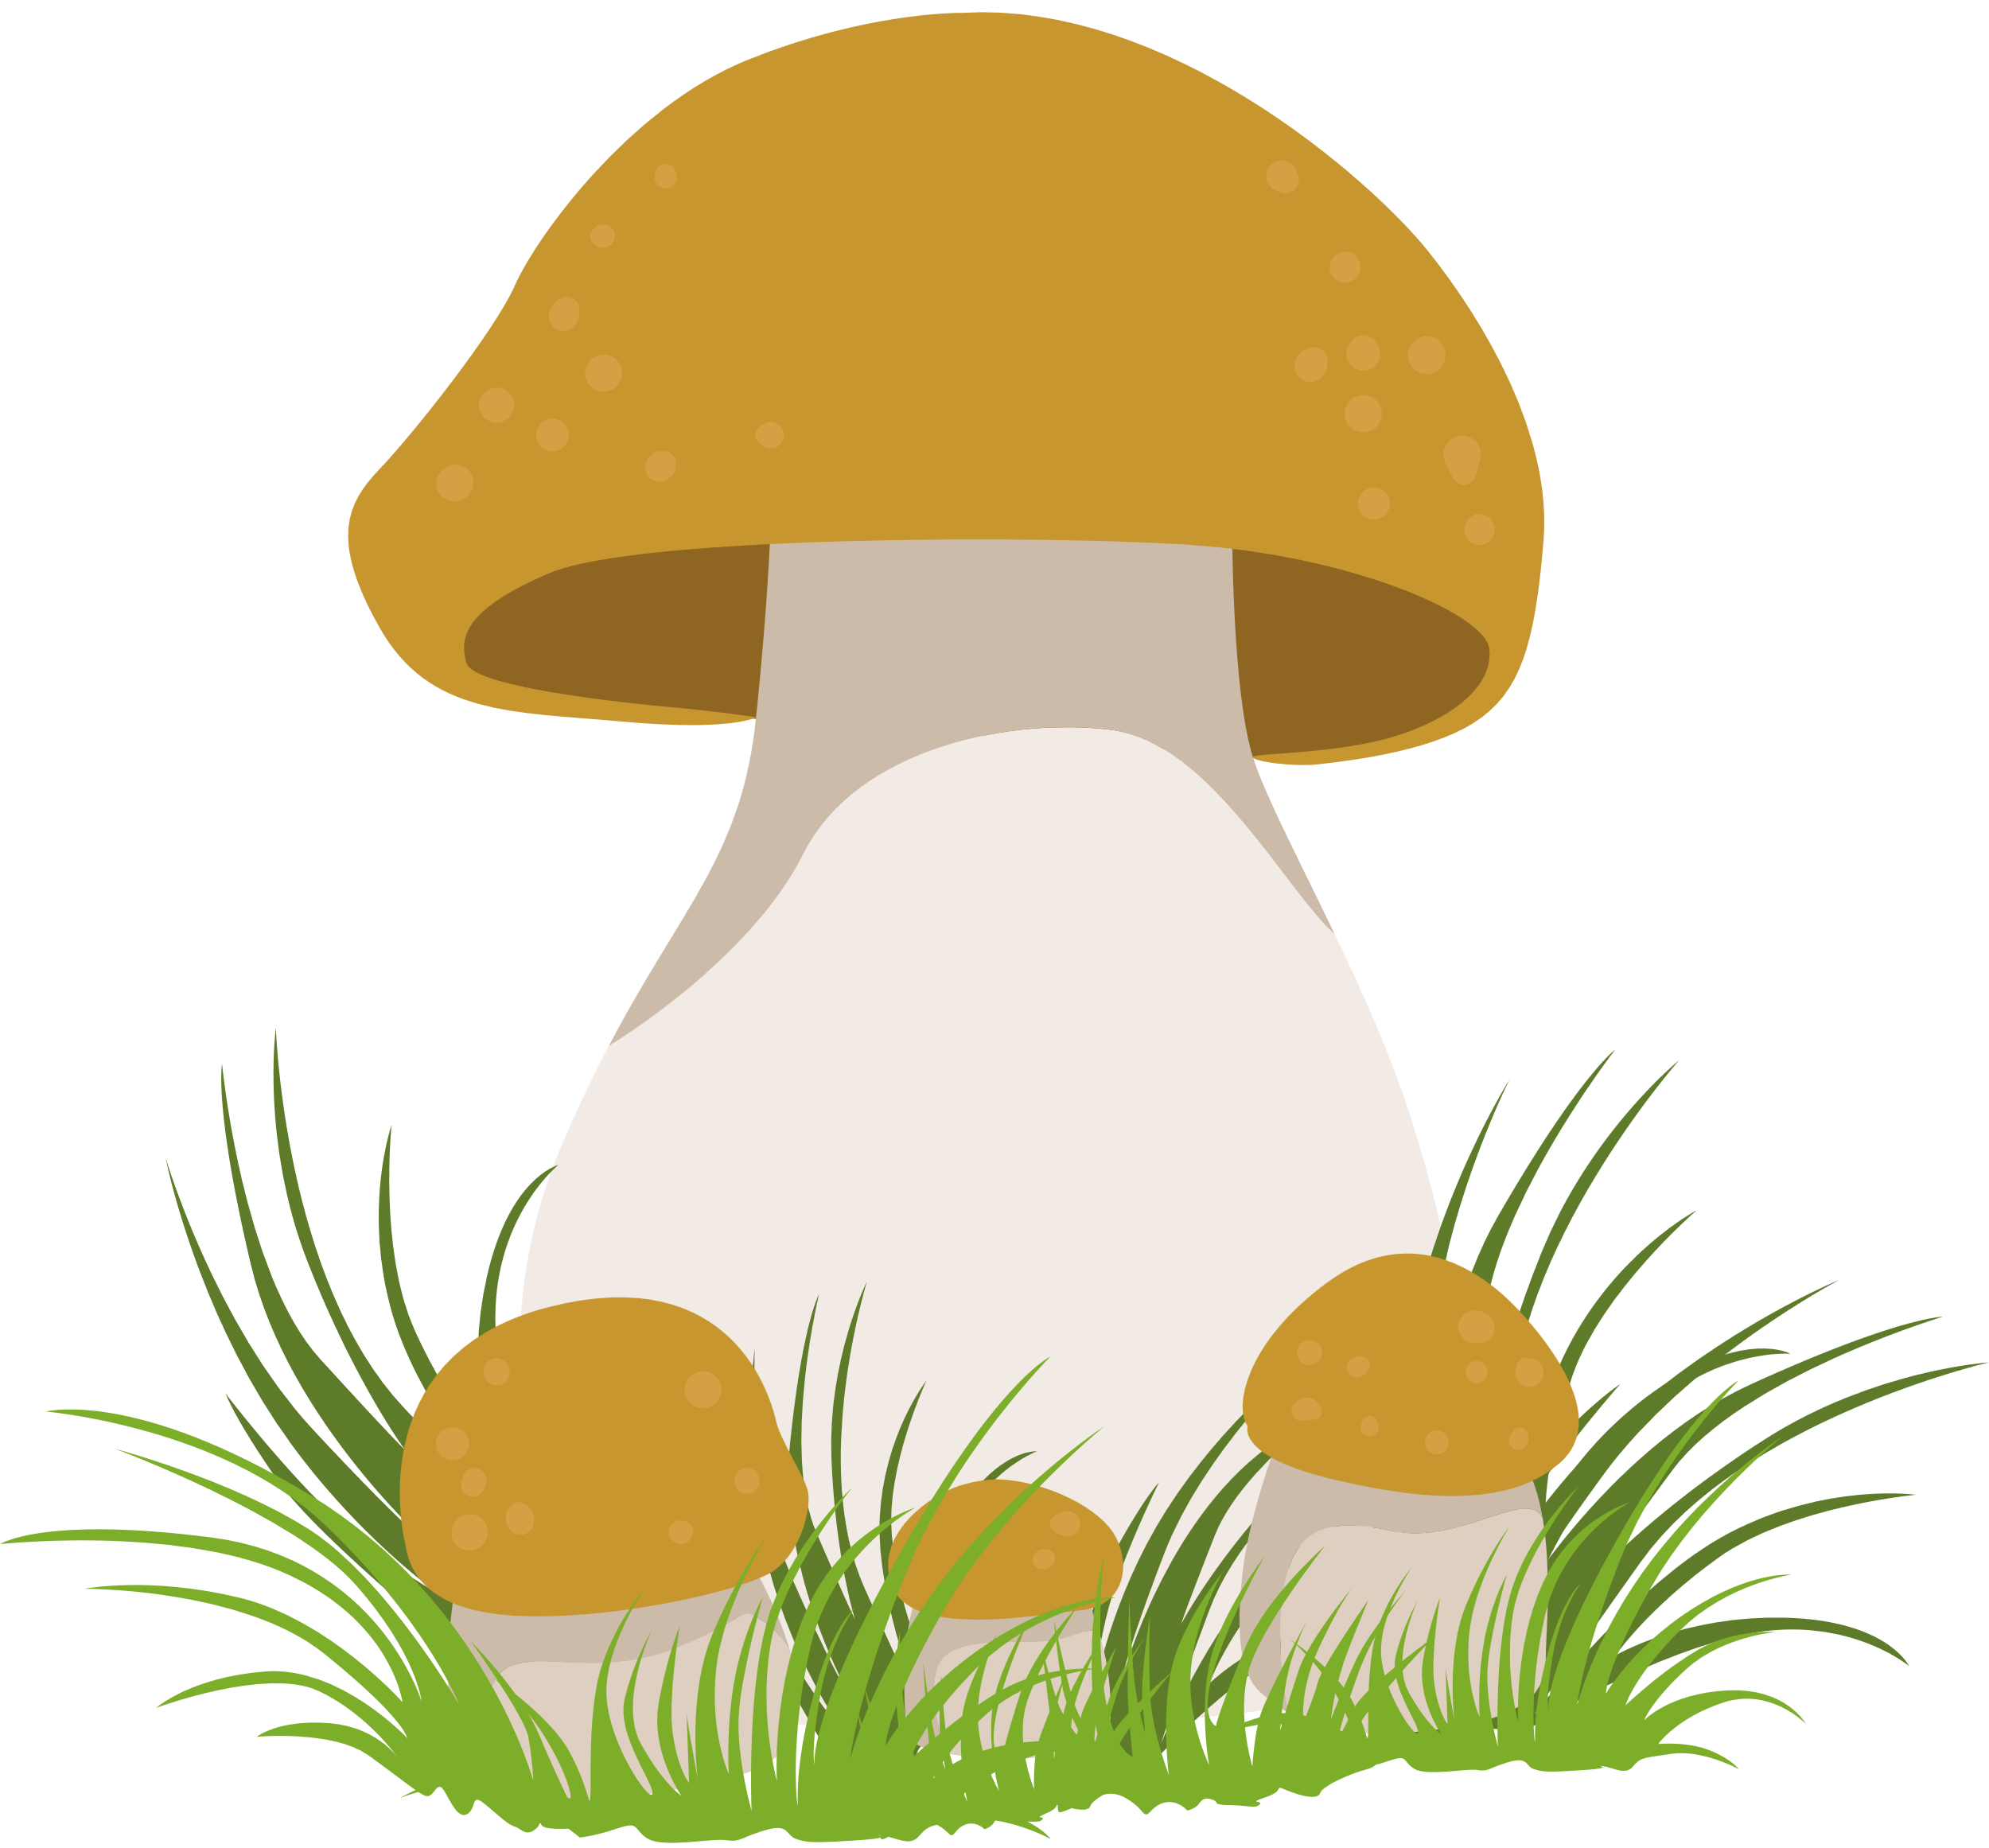

fungi
We sometimes see the ‘fruit’ of fungi, like mushrooms, in the forest.

Slide 5


fungi
mycelium
Like trees, fungi also have root-like structures, called mycelium.
Mycelium is made up of hyphae.

Slide 6
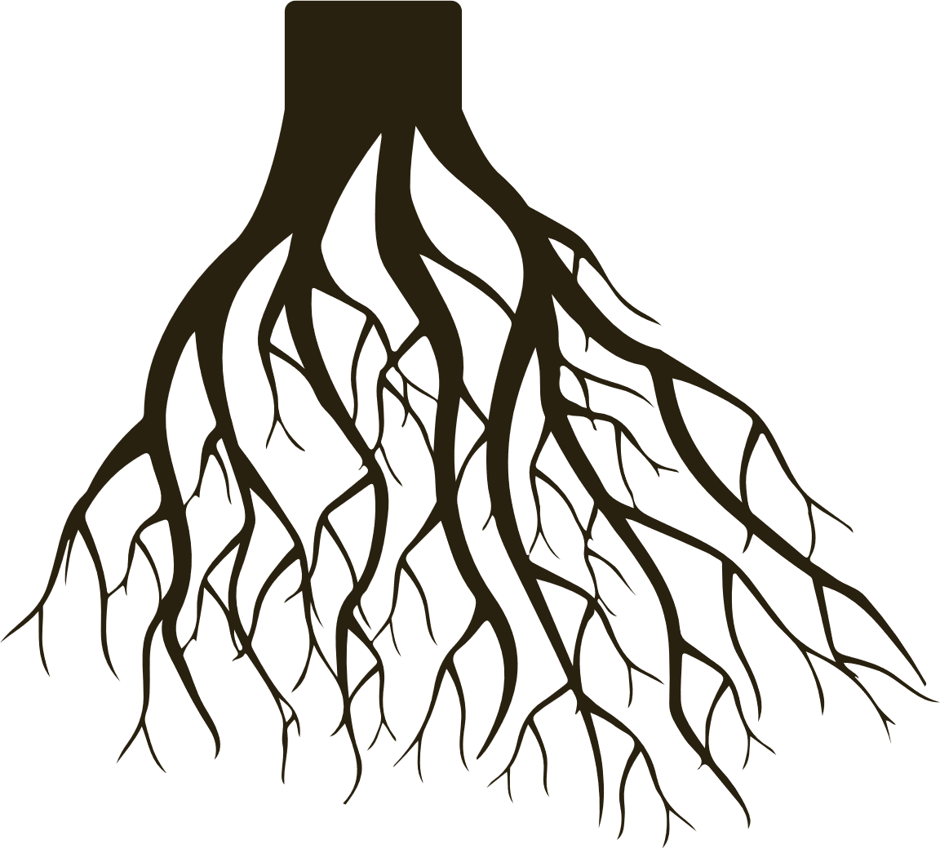

fungi
mycelium
Tree roots
We help each other!
Mycelium and tree roots have a symbiotic relationship.
Symbiotic relationship means that more than one organism is interacting with each other.

Slide 7
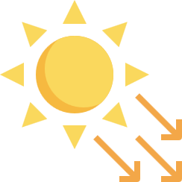



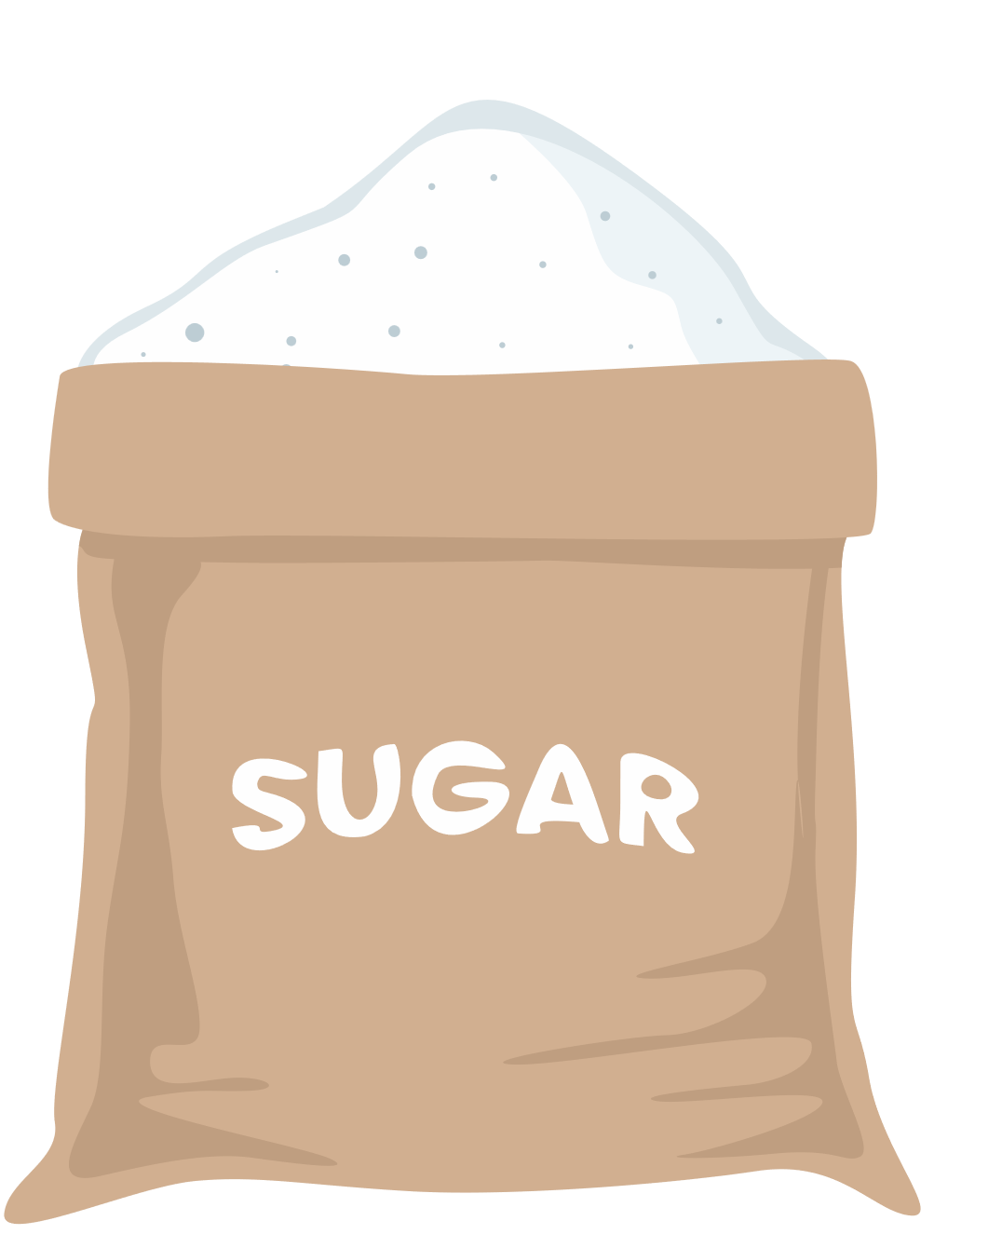
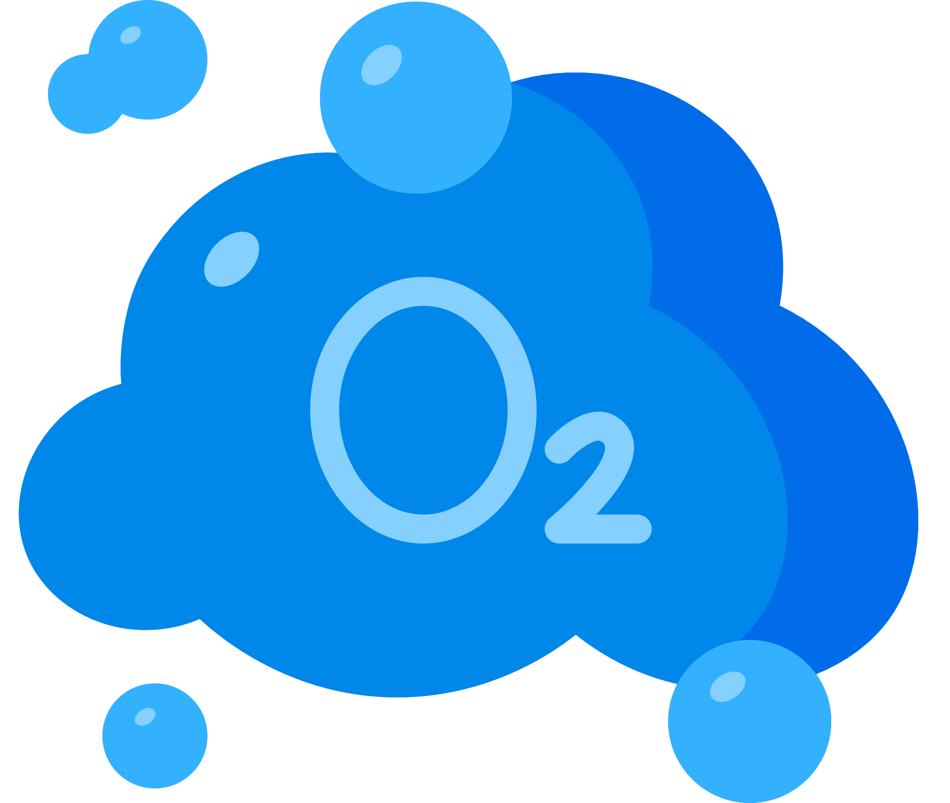



Trees produce sugars and oxygen through photosynthesis.

Slide 8

sugars
Trees provide sugars to mycelium, helping fungi grow.

Slide 9
Mycelium spreads further than tree roots and connects different trees together.

Slide 10
mycorrhizal network
These connections form mycorrhizal networks.

Slide 11

nitrogen
carbon
Mycorrhizal networks help trees share resources with each other.
Thus, they have a symbiotic relationship!

Slide 12
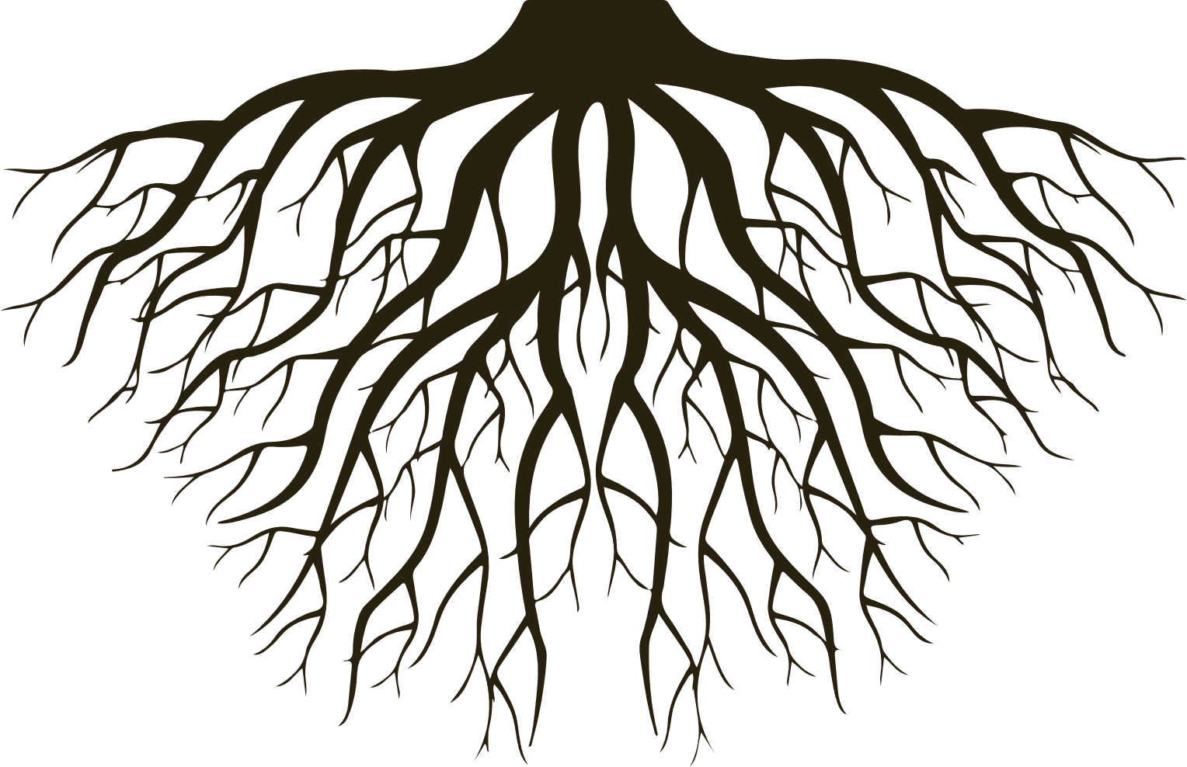
mother tree
young tree / sapling
fungi
mycelium
Older trees, called Hub Trees or Mother Trees have more connections than younger trees.

Slide 13
mother tree
young tree / sapling
fungi
mycelium
carbon
Mother trees share resources with younger trees, helping them to survive and grow.

Slide 14


Forest Communities Worksheet Part 1 - Instructions
Imagine you are a young sapling in the forest, attempting to survive your first year. You will need the older trees to help you grow.
Respond to the questions on the left side of the paper and reflect upon the things and people that help you to grow as a human!
Imagine you are a Mother Tree, the largest tree in the forest that younger saplings rely on for help.
At different times in our life we need help, at other times we help others. Respond to the questions on the right side of the paper and reflect upon times when you’ve helped others grow (humans, animals, and plants included!).

