Slide 1
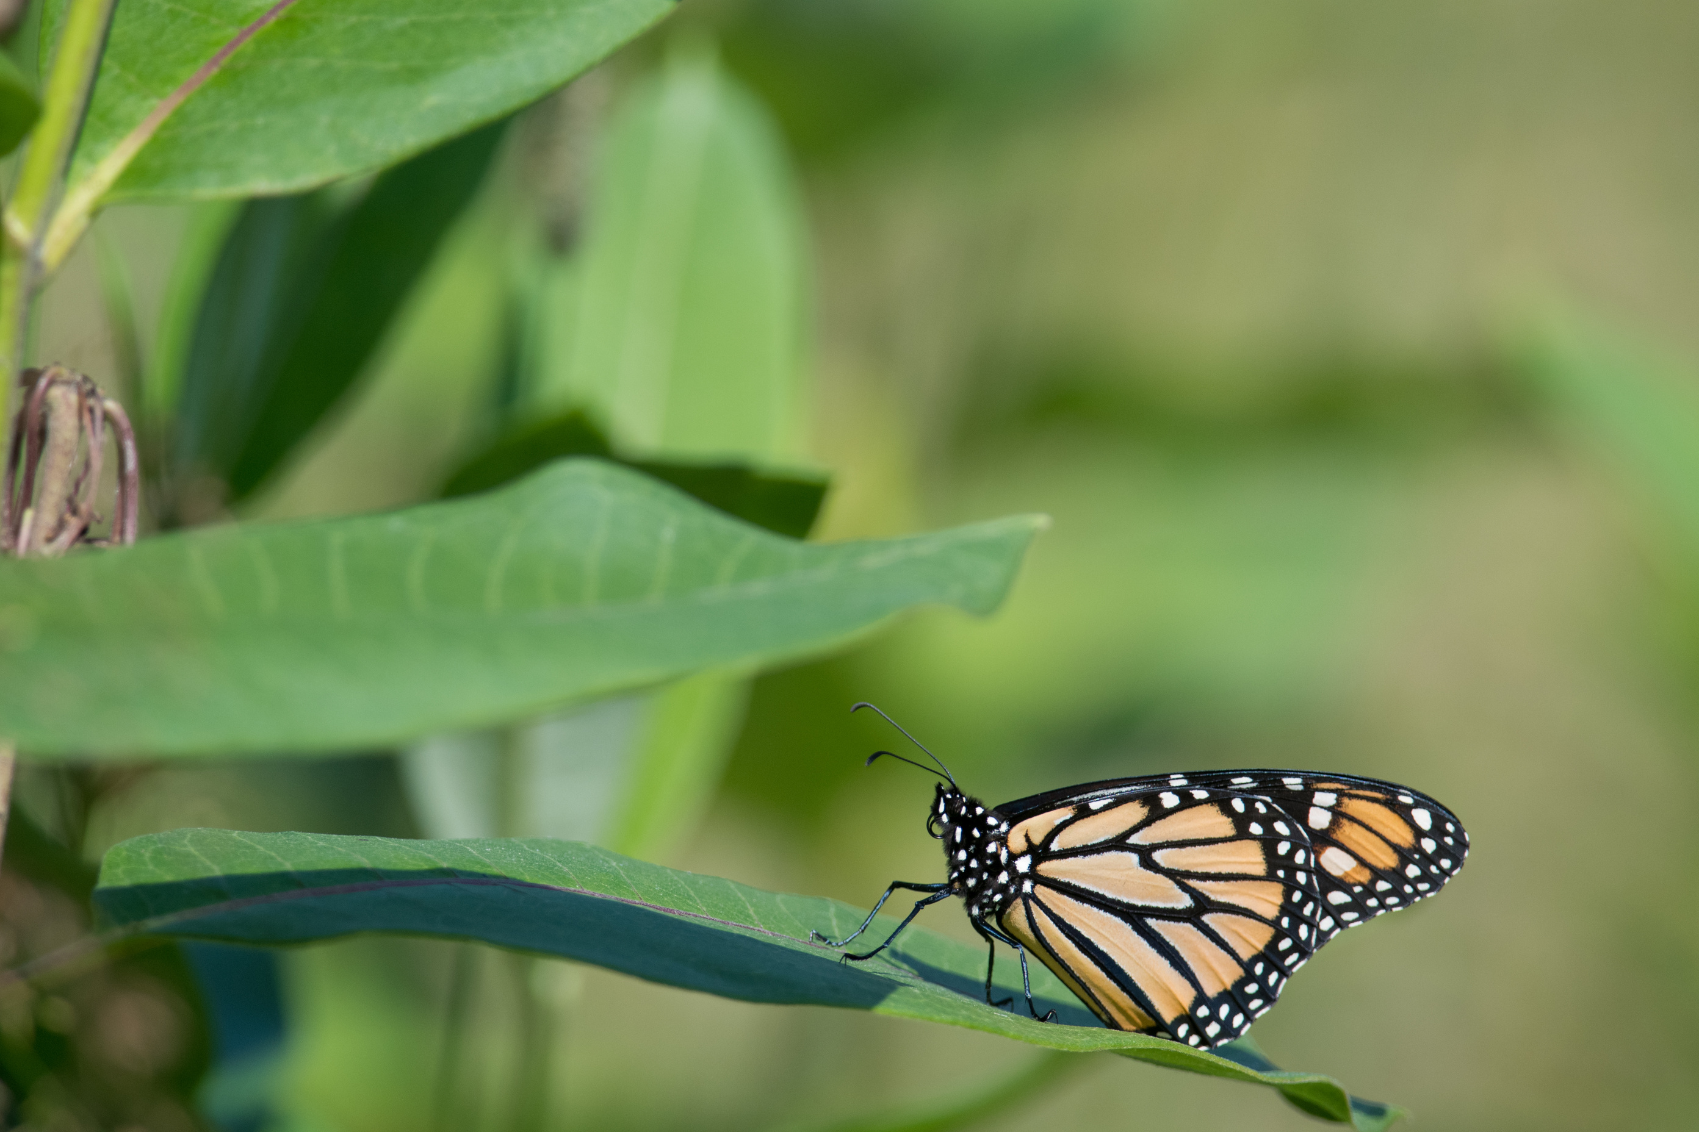




Reciprocity

Slide 2
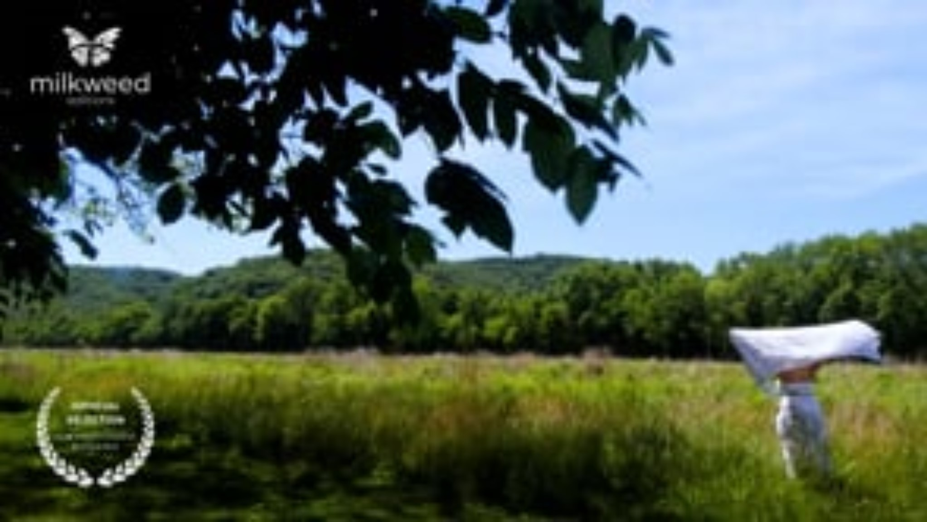
Source: Robin Wall Kimmerer

Slide 3
Discussion Questions
  What does the narrator mean by, ‘alone is a word without meaning in this forest’?
  How did this video describe or depict relationships in the forest?
  What does the word ‘reciprocal’ mean? Why did the narrator say the ‘relationship between the world and self is reciprocal?’

Slide 4
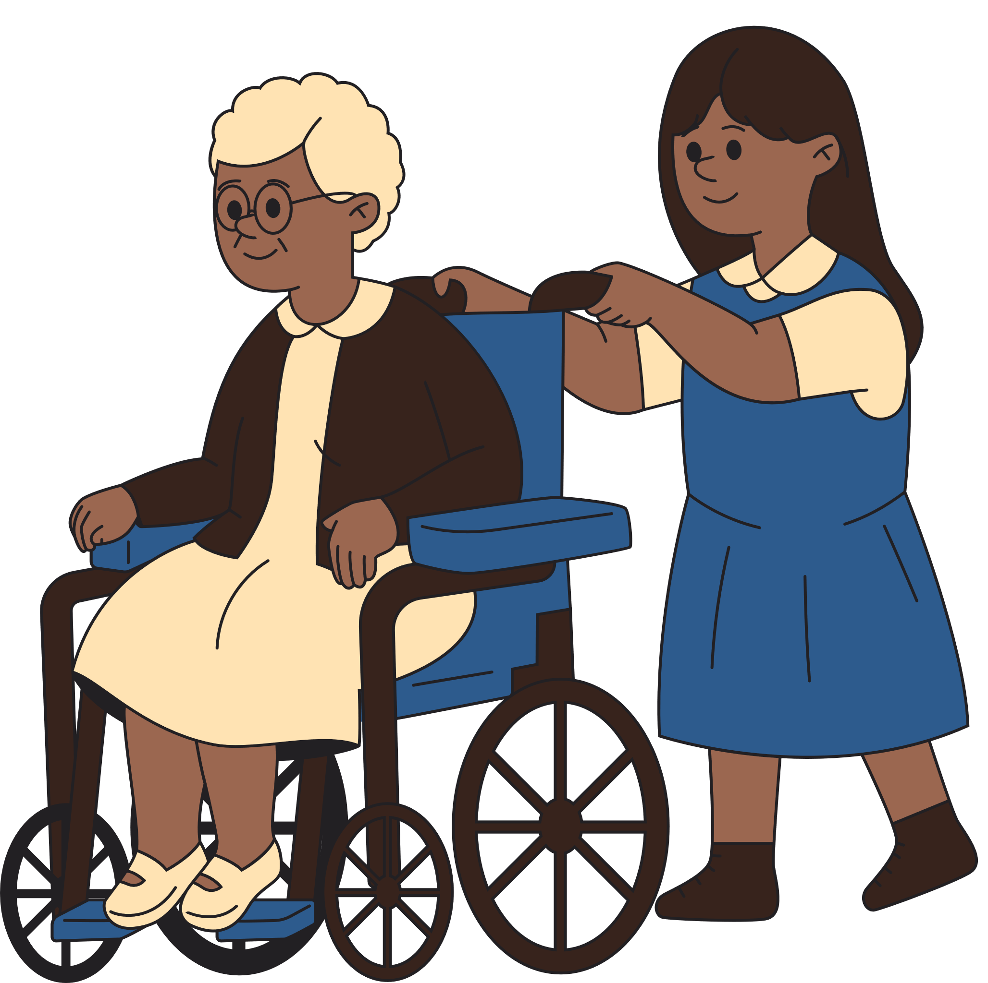
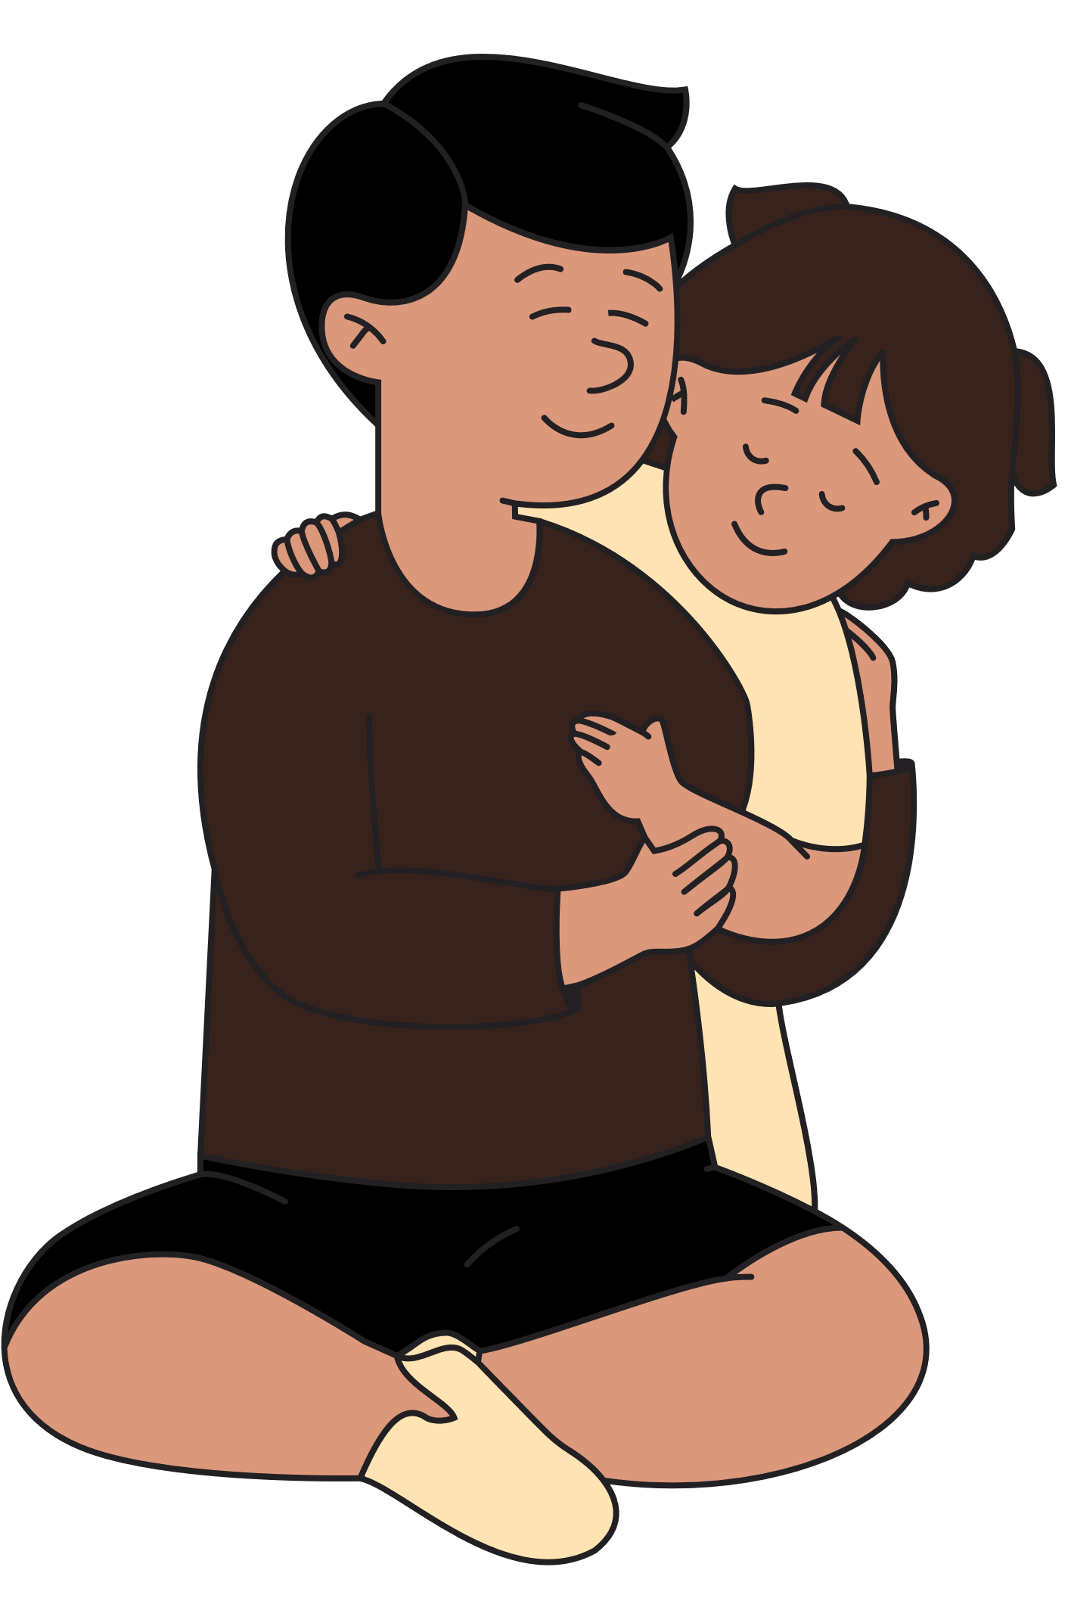
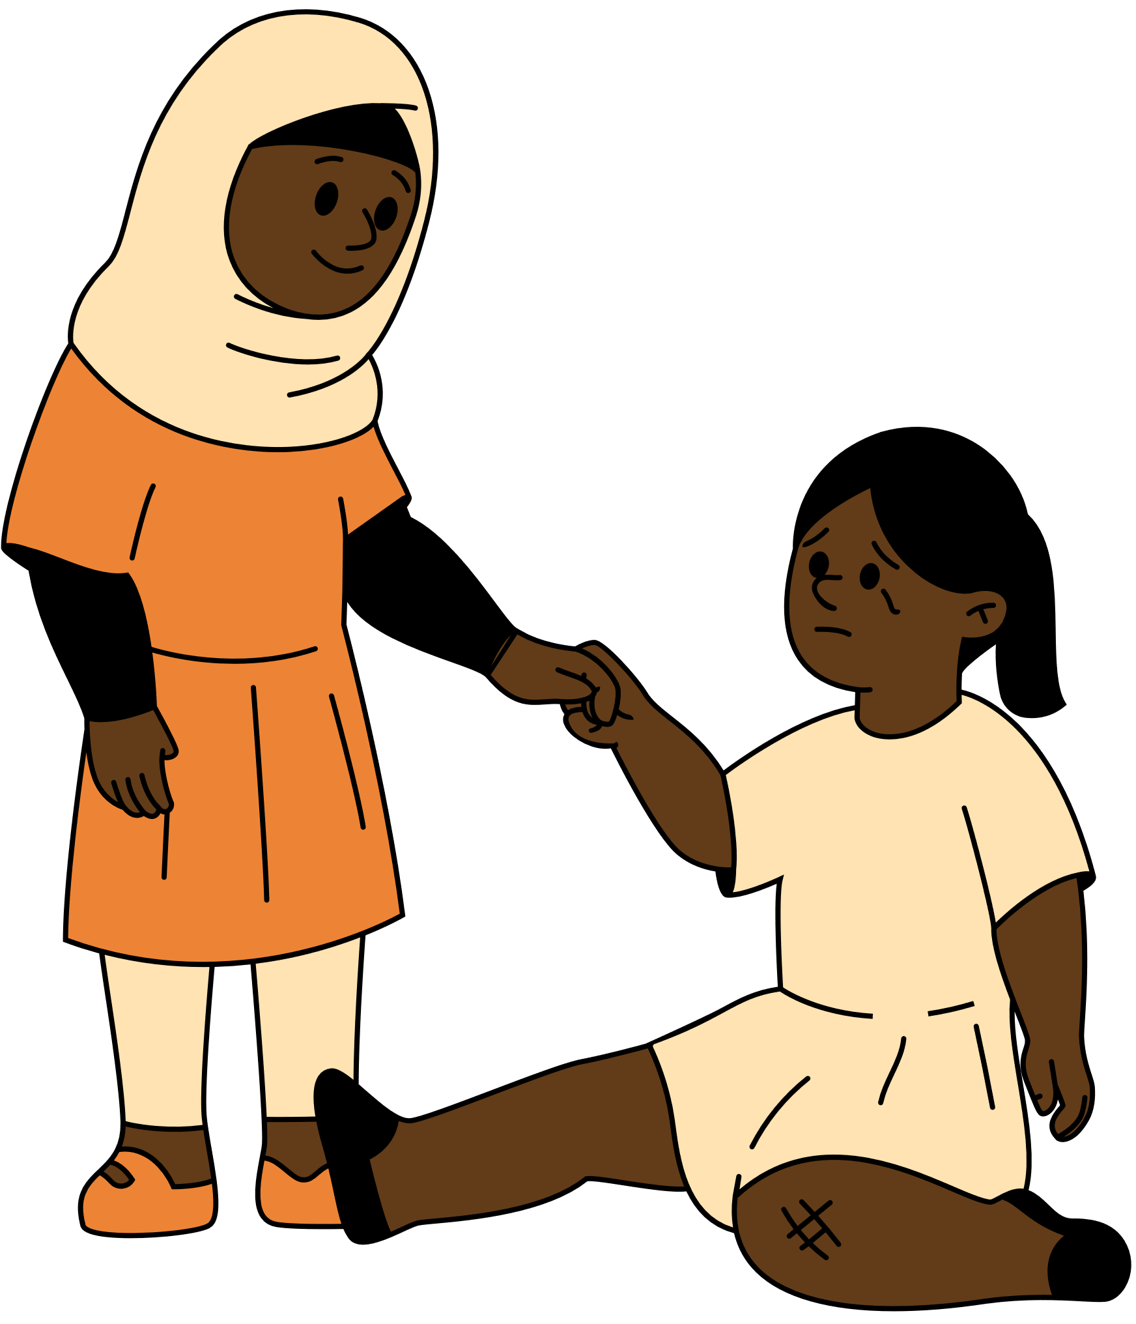
Reciprocal relationships refer to relationships that benefit both people.
Why might the relationships above be described as reciprocal?

Slide 5
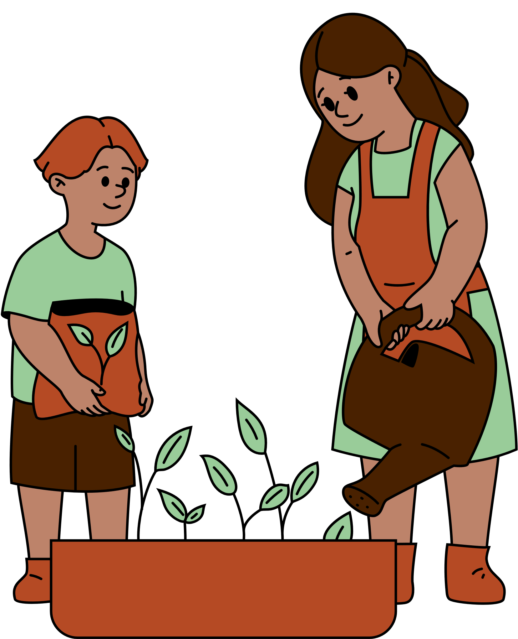
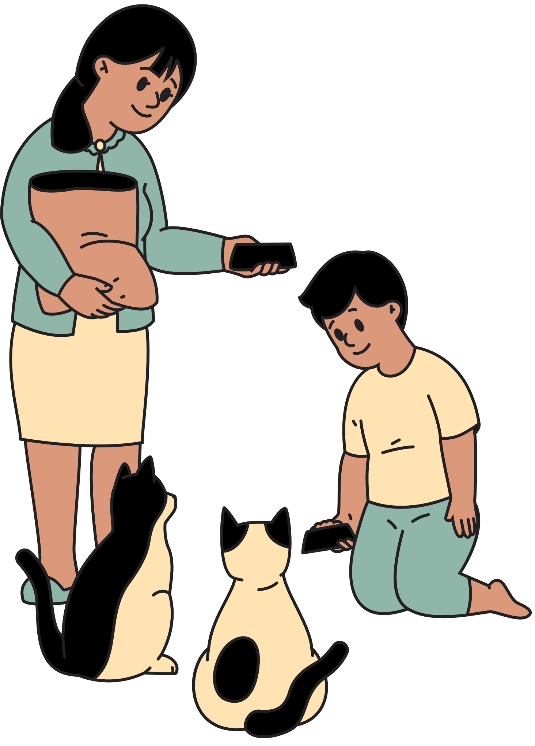
We can also have reciprocal relationships with animals and plants.
Why might the relationships above be described as reciprocal?

Slide 6
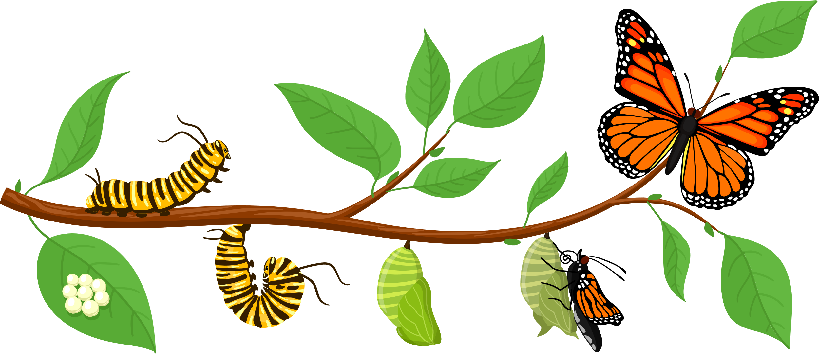
Plants and animals can also have reciprocal relationships with each other.
Scientists refer to these relationships as a type of symbiosis known as mutualism.

Slide 7
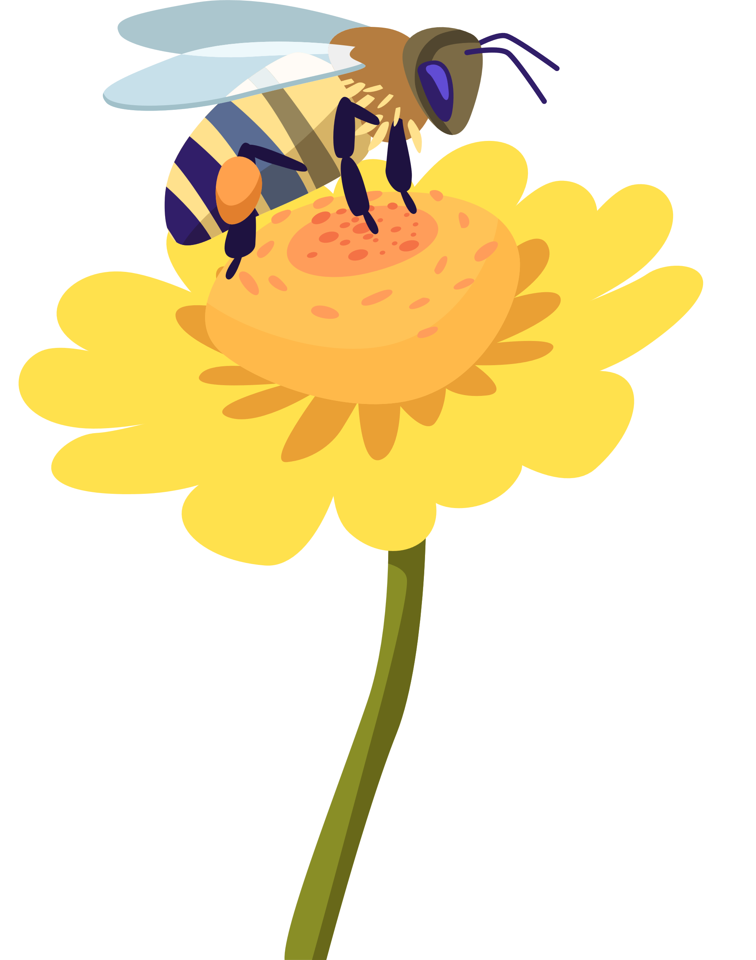
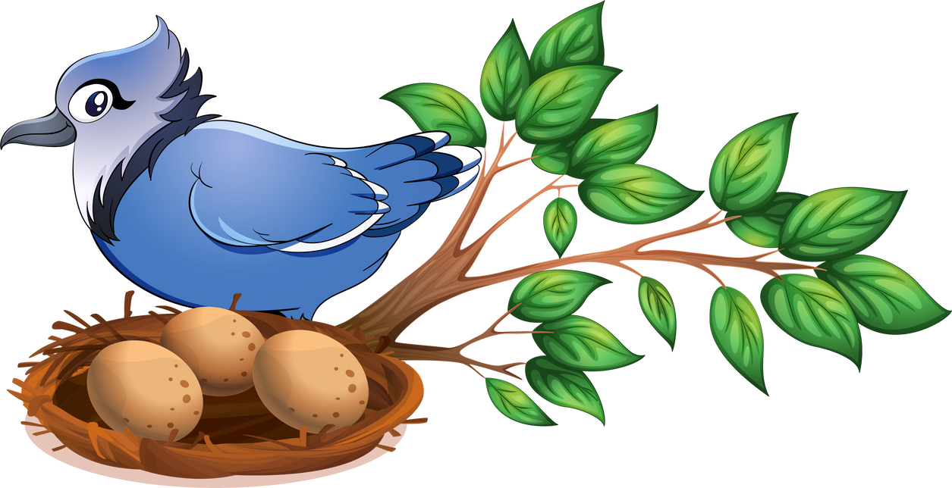
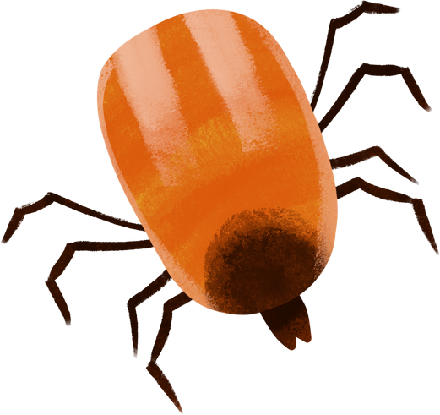
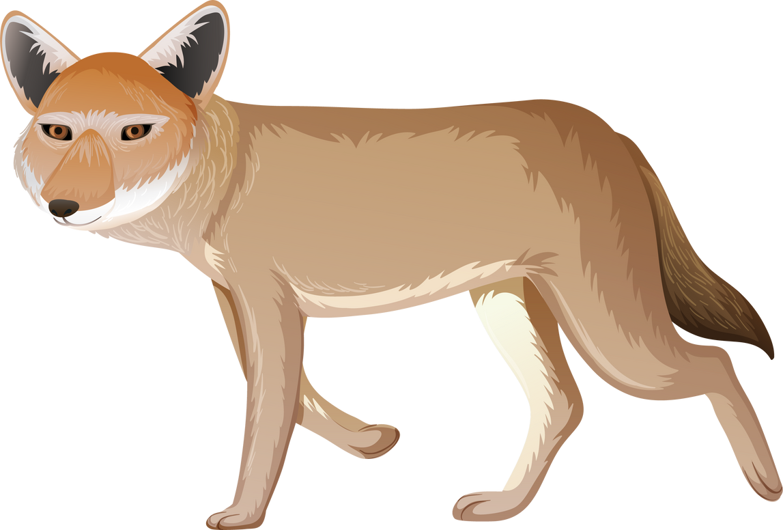
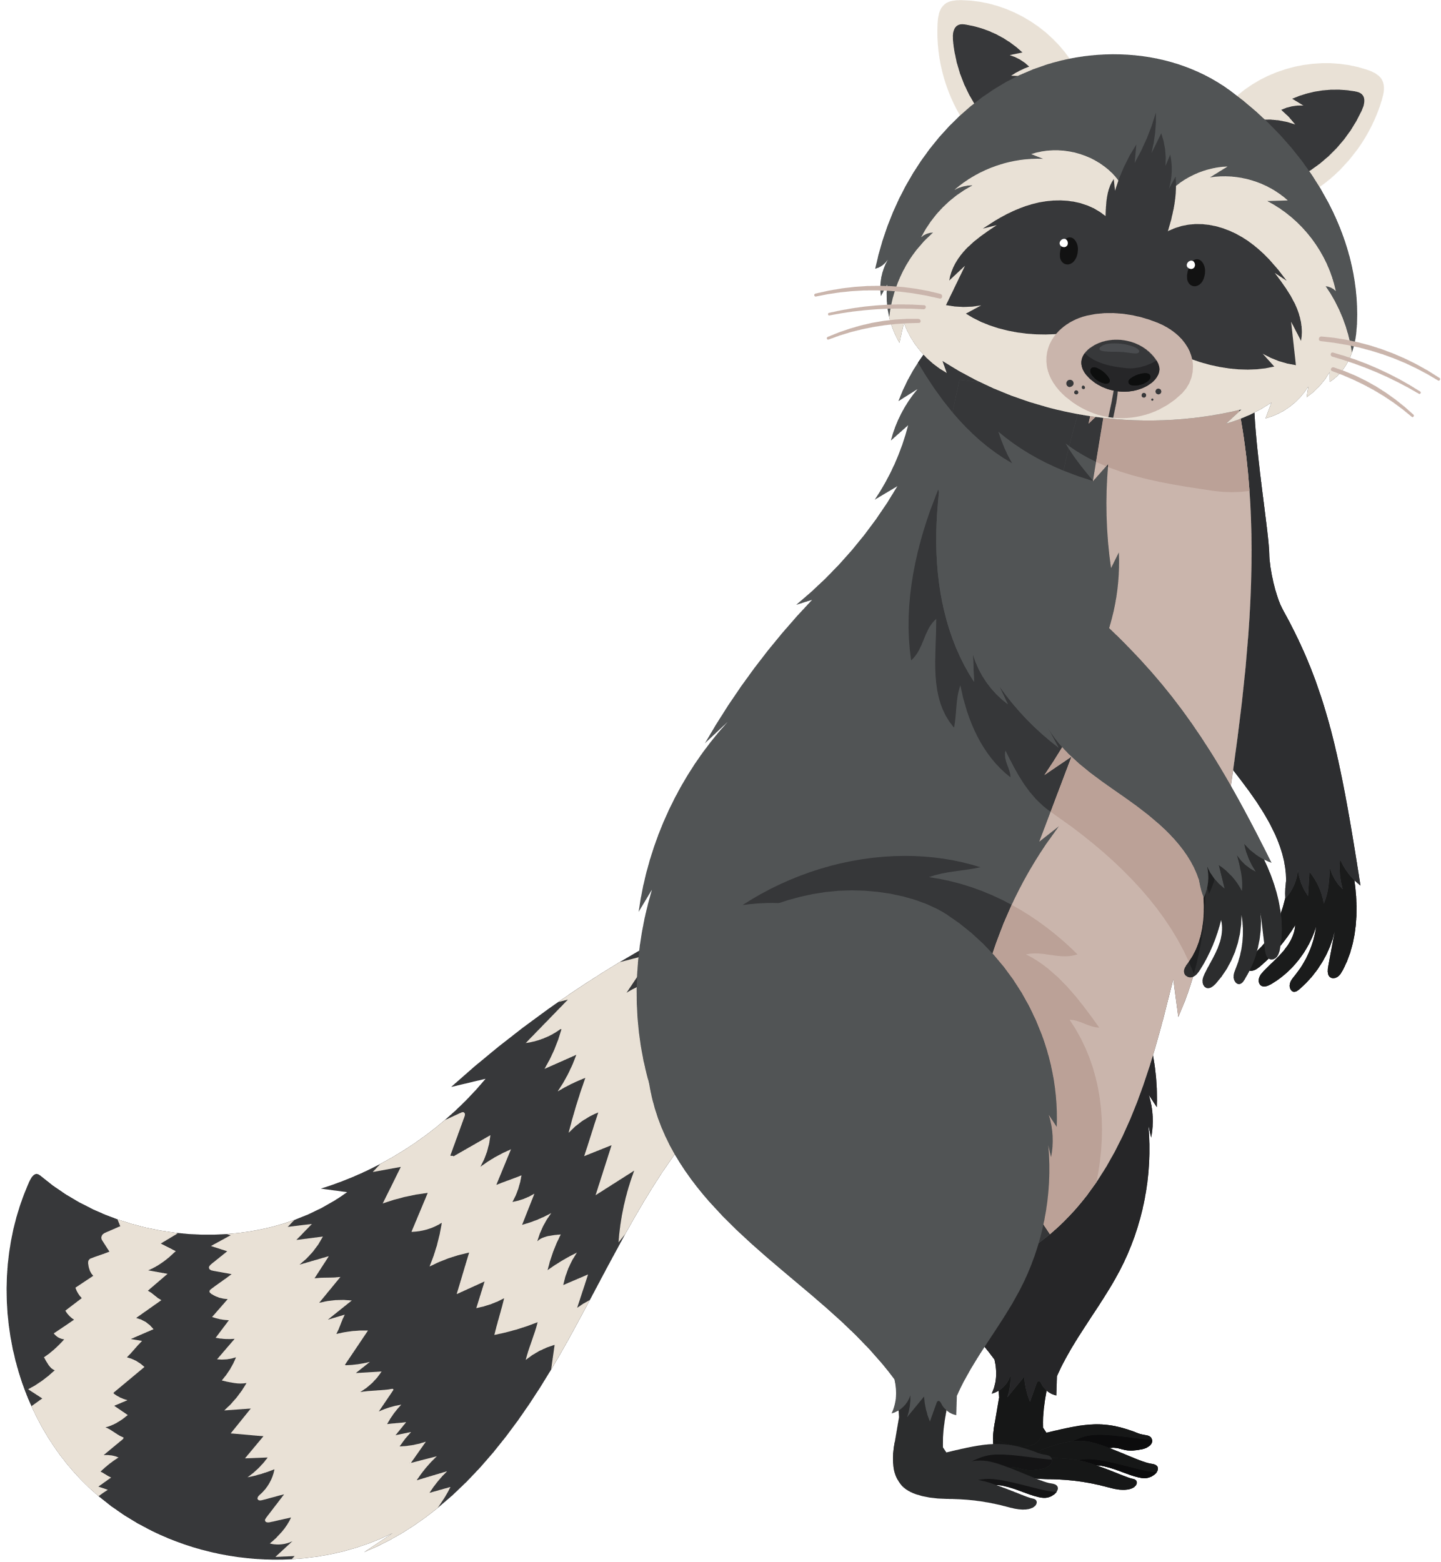
Mutualism
Commensalism
Symbiosis
A term to describe a long-term relationship or interaction between two different organisms.
Both organisms benefit.
One organism benefits, while not harming the other.
Parasitism
Competition
Source: National Geographic
One organism benefits while the other is harmed.
Organisms are in competition for the same resources.

Slide 8
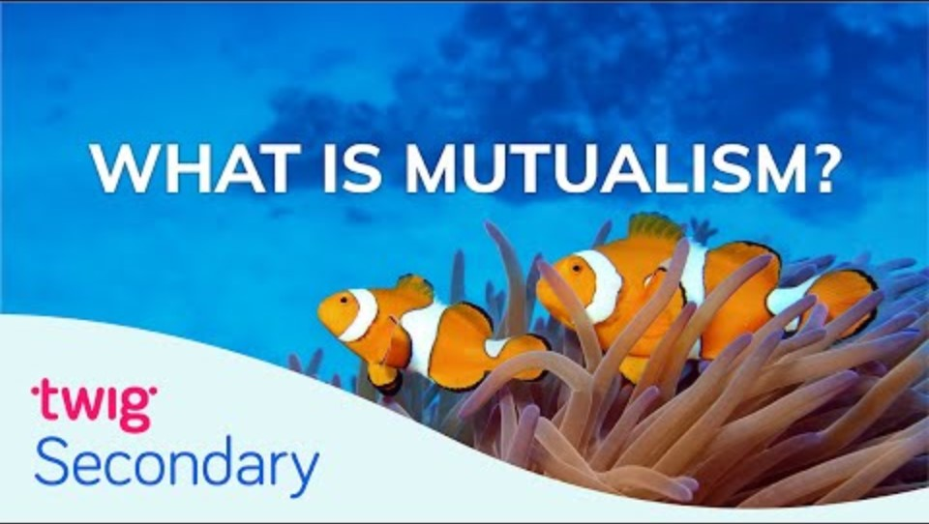
Source: Twig Science Reporter

Slide 9
Discussion Questions
  What are examples of reciprocal relationships or mutualism in your own life? These relationships could be with other humans, animals, or plants.
  Why is it important to have reciprocal relationships?

Slide 10

Source: Reciprocity Project

Slide 11
Discussion Questions
  How are reciprocal relationships depicted or described in this video?
  How does the narrator express gratitude to the land?
  According to the narrator, why is it important to express gratitude and give thanks to the land?

